Slide 1

Introduction to Multimedia
LECTURE 9

Slide 2
Combination of multiple forms/ media of content
Text
Images
Audio
Movies
Interaction

Slide 3
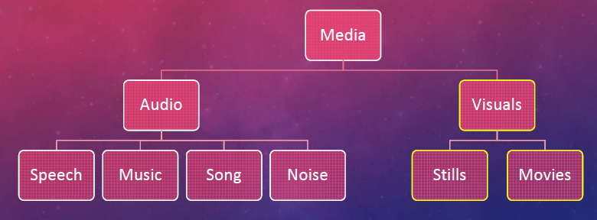
Media Classification

Slide 4
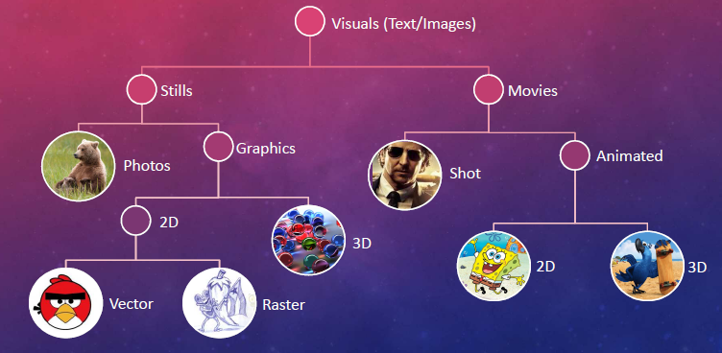
Media Classification

Slide 5
Formats and Compressions
Different media formats use different compression techniques to reduce the file size for better storing, communicating and processing capabilities.
Lossy compression
  The original file is damaged while compressing
  There can be a quality loss too
Lossless compression
  The file is not damaged
  No quality drop

Slide 6
Formats and Compressions
Images;
JPEG – Lossy compression
TIFF – Lossy / Lossless
GIF – Lossless / support animation
PNG – Lossless

Slide 7
GIMP

Slide 8
Introduction to GIMP
GIMP is an acronym for GNU Image Manipulation Program.
It is a freely distributed program for such tasks as
  photo retouching,
  image composition and
  image authoring.

Slide 9
Advantages - That Make Gimp Worth Learning
GIMP is free but it is powerful as Photoshop.
With GIMP you can,
  Create website graphics like banners, buttons and patterns from scratch
  Enhance and retouch digital photos
  Consists of versatile selection and transformation tools
  Also it has all the advance features like layers and paths

Slide 10
Activity
Go to the following link and complete the given tasks
  https://www.gimp.org/tutorials/GIMP_Quickies/
Learning Outcomes,
  Changing the Size (Dimensions) of an Image (Scale)
  Changing the Size (Filesize) of a JPEG
  Crop an Image
  Rotate or Flip an Image

Slide 11
For more guidance.....
HOW TO USE GIMP - Complete Tutorial for Beginners 2020 https://www.youtube.com/watch?v=x6pXJ7Ijir0
GIMP 2.10 Basics: Complete Overview Tutorial for Beginners https://www.youtube.com/watch?v=2EPIUyFJ4ag
Learn GIMP in 25 Minutes | 10 Things GIMP Beginners Need to Know https://www.youtube.com/watch?v=1MLnP0OiEkw

